Slide 1
Difficulty Factors for VR Cognitive Rehabilitation Training – Crossing a Virtual Road
Computers & Graphics (2019)

Slide 2
Introduction
1. Strokes are the most common cause of disability.
2. Cognitive impairments such as unilateral spatial neglect (单侧空间忽略) or visual field defects (视野缺损) occur frequently.
3. These lead to problems with activities of daily living (ADL), such as movement in public space.
4. Computer-assisted rehabilitation is important, because there is a shortage of therapists to treat the growing number of aﬀected persons alone.

Slide 3
Introduction
5. This paper examines VR-based cognitive training in the form of safe road crossings.
6. The main goal is to improve cognitive abilities and to encourage patients to pay more attention to their neglected side.
7. A safe crossing is when there are more than 1.5 seconds between leaving the respective roadway and the arrival of the car at this point.
8. Simulators for learning safe road crossings with the help of virtual reality have already been successfully applied to children.

Slide 4
Virtual Environment
1. The task of the users was to decide whether or not the occurring gap in road traﬃc allowed a safe road crossing.
2. By pressing the trigger button on the HTC Vive Controller once, the user signals that they would now cross the road and the avatar starts to walk automatically.
3. The avatar then tries to successfully cross the road in a straight line at a speed of 1.45m/s while the user stays in third-person view at the roadside.
4. The user therefore does not perform any walking movement in the real world.

Slide 5
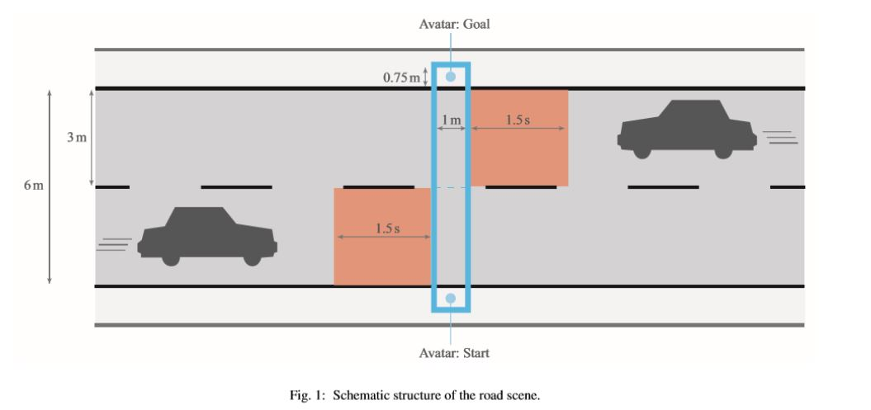

Slide 6
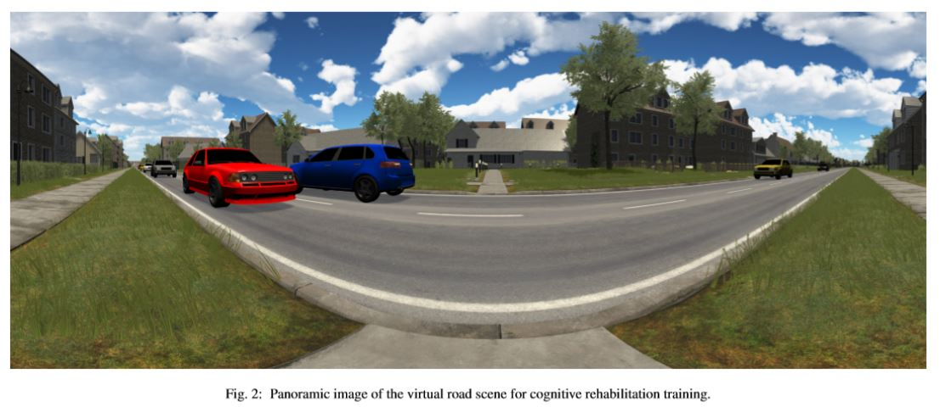

Slide 7
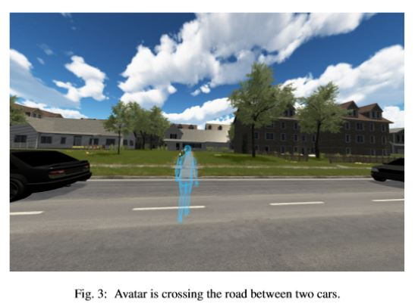

Slide 8
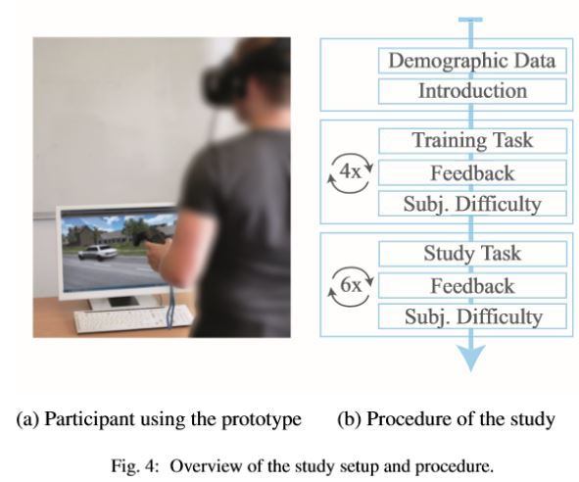
User Study
1. Participants
(1) 60 healthy participants (24 female, 36 male), who were aged between 16 and 79 years.
2. Procedure
(1) 4 training trials and 6 test trials out of the 36 scenarios.

Slide 9
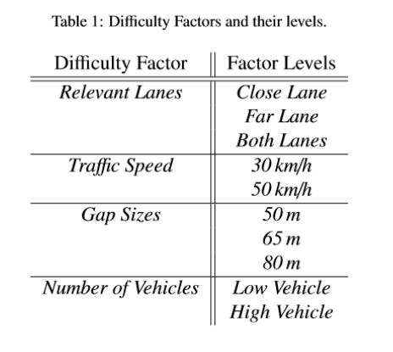

Slide 10


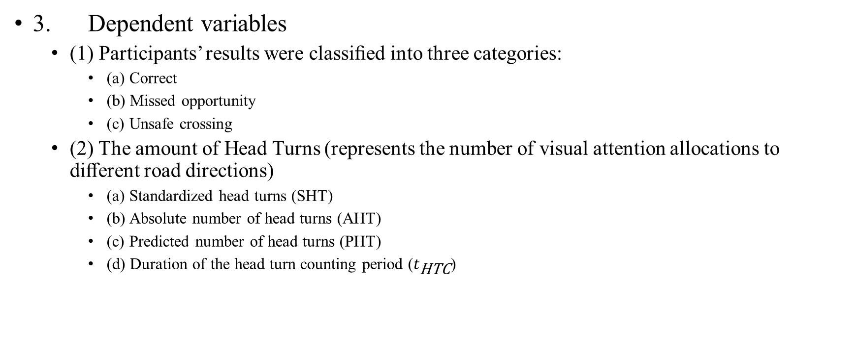
User Study
3. Dependent variables
(1) Participants’ results were classiﬁed into three categories:
(a) Correct
(b) Missed opportunity
(c) Unsafe crossing
(2) The amount of Head Turns (represents the number of visual attention allocations to diﬀerent road directions)
(a) Standardized head turns (SHT)
(b) Absolute number of head turns (AHT)
(c) Predicted number of head turns (PHT)
(d) Duration of the head turn counting period ($t_{\text{HTC}}$)

Slide 11
User Study
3. Dependent variables
(3) Subjective Estimate of the diﬃculty: “Very Easy”, “Easy”, “Slightly Easy”, “Slightly Diﬃcult”, “Diﬃcult”, “Very Diﬃcult”.

Slide 12
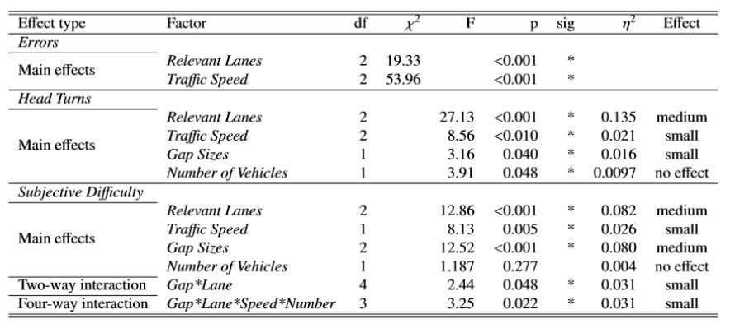
Results
1. Effect size

Slide 13
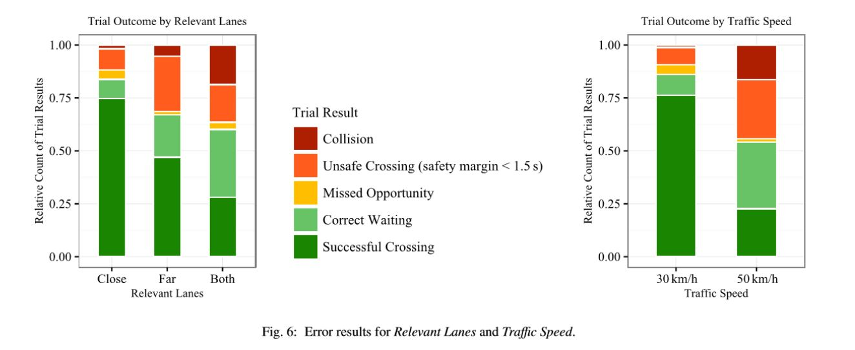
Results
2. Error

Slide 14
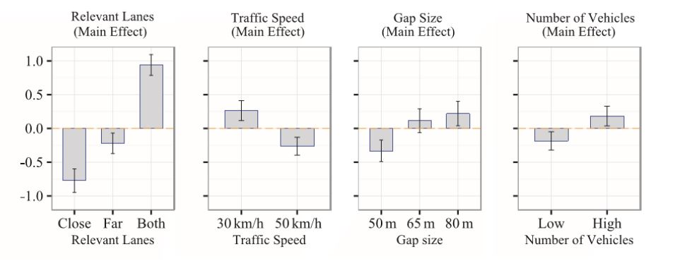
Results
3. Results of Standardized Head Turns

Slide 15
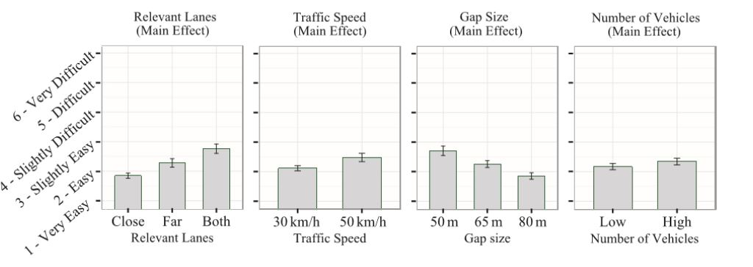
Results
4. Results of Subjective Diﬃculty

Slide 16
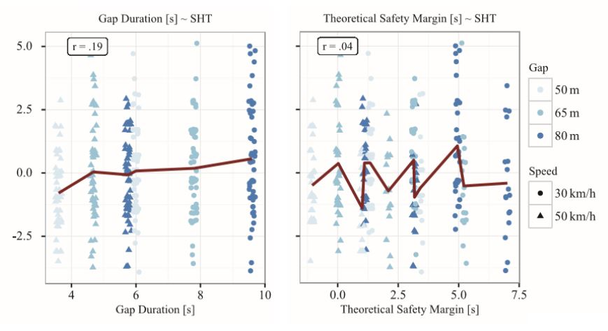
Results
5. Gap Duration

Slide 17
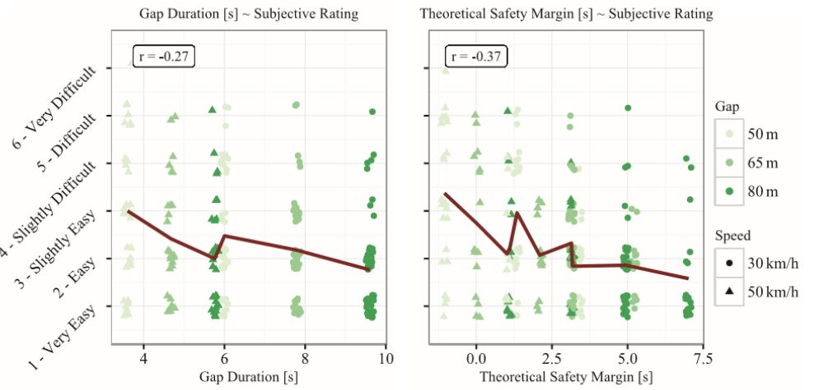

Slide 18
Conclusion
1. The factors of the Relevant Lanes and the Traﬃc Speed have the greatest inﬂuence on the perceived task diﬃculty.
2. However, a clear inﬂuence of the Gap Size could not be shown.
3. The Number of Vehicles, on the other hand, showed no measurable diﬀerence.

Slide 19
Limitations
1. The environment (same speed, straight street, same vehicles) could be even more realistic.
2. The screen door eﬀect of HDMs.
3. We evaluated the diﬃculty factors with healthy participants.

